Slide 1
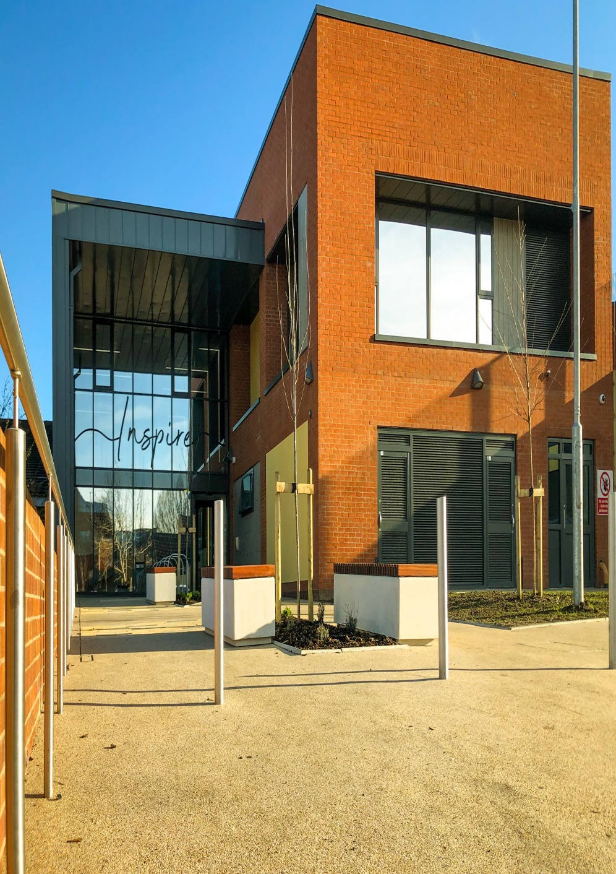


Humber
Dialectical
Behaviour
Therapy
Providing
comprehensive
DBT across Hull
and East Yorkshire
Publication Date: 06.10.25
Review Date: 06.10.27

Slide 2
Humber Dialectical Behaviour
What is Dialectical Behaviour Therapy (DBT)?
DBT is a therapeutic approach
recommended for people for whom reducing self-harm and suicidal behaviour is a priority. Alongside reducing such behaviour, DBT aims to help people work towards the goals they have for their life. Whilst supporting people to change, we aim to help people understand and validate their own emotions and experiences, rather than us simply asking people to do something different.
What does the DBT team do?
We offer:
Training to teams Trustwide
Supervision and consultation to other teams
Direct treatment with the team
Support for family, friends, and other supporters through the Humber Family Connections Service
Because we are a small team,
unfortunately we aren’t able to offer direct treatment to everyone who experiences self-harm and suicidal behaviour, so have to use certain criteria to decide which referrals to accept. Even if you do not meet the criteria for direct treatment, we will be happy to support other people to offer you DBT-informed support.
What does direct treatment involve?
If the team accepts a referral for you for direct treatment, one of us will get in touch to arrange approximately 4 pre-treatment appointments for us to meet and agree together whether DBT is the right approach for you. If it is, direct treatment initially involves attending a weekly skills training group to learn skills in mindfulness, distress tolerance, emotion regulation, interpersonal effectiveness, and achieving balance in life. You will also have individual sessions with a DBT Therapist, and telephone coaching between sessions to support you in implementing the skills you’ve learned in sessions to everyday life. The therapists in the team also meet weekly at our consultation meeting to discuss our work to ensure we are working effectively.

Slide 3

What would I need to do if I had
direct treatment?
We would expect you to show
commitment to the treatment, which we usually assess by your attendance and engagement in the things we ask you to do as part of
DBT. We may change the things we expect from you where we think it will be helpful to you for us to do so. You would need to practice what you are learning at your sessions between sessions. Individual treatment also involves completing a diary card every day recording how often harmful behaviours and skilful behaviours occur during your week. After completing your first round of skills group, the consultation team meet to discuss whether DBT seems to being helpful for you; if not, we may consider discharging you from DBT, as we don’t want to keep doing something that isn’t helping you. We assess whether DBT is helping in a number of ways, including whether you have been able to reduce or stop utilising self-harm or suicidal behaviour as a coping strategy. If DBT seemed to be helping then we would offer you further sessions if you wanted them.
Where do sessions take place?
DBT group sessions are held at 77 Beverley Road, Hull, HU3 1XR. This is based in Hull City Centre, within walking distance of the transport interchange. Individual sessions also typically take place here, though these may be offered at any available base within the area with agreement between yourself and your allocated therapist, provided we have capacity to do so (please let us know as soon as possible if you think coming to 77 Beverley Road will be a problem for your individual sessions).
How can I find out more about
DBT?
If you would like to speak to us, you can call us on 01482 689154 or email us on hnf-tr.humberdbt@nhs.net. You can
also speak to your care coordinator or other worker in
mental health services about the
service, and Mind produce a more detailed overview of DBT available at the following link: https://www.mind.org.uk/information-support/drugs-and-treatments/talking-therapy-and-counselling/dialectical-behaviour-therapy-dbt/
Essential reading
Skills-based caring for a Loved One with an Eating Disorder, Janet Treasure, July 2016.
Helpful websites
camhs.humber.nhs.uk
beateatingdisorders.org.uk
seedeatingdisorders.org.uk
youngminds.org.uk
anorexiafamily.com

Slide 4








CONTACT US
https://www.humber.nhs.uk/services/older-peoples-mental-health-services/dialectical-behaviour-therapy/
Mental Health Advice and Support Line (24 Hours): 0800 138 0990 (non-DBT crisis support)
NHS Direct: 111
Emergency Services: 999
Complaints and Feedback Team
Humber Teaching NHS Foundation Trust
Trust HQ, Block A, Ground Floor,
Beverley Road,
Willerby Hill,
Hull, East Riding Of Yorkshire,
HU10 6FE
01482 303930
HumberNHSFT
HNF-TR.complaints@nhs.net
HumberNHSFT
humber.nhs.uk

