Slide 1
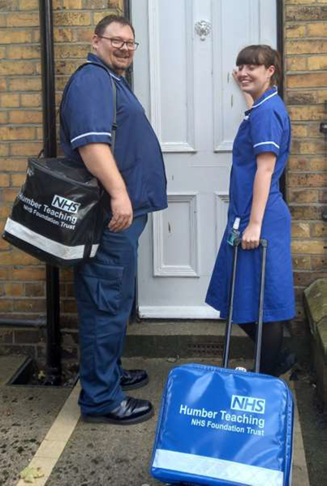
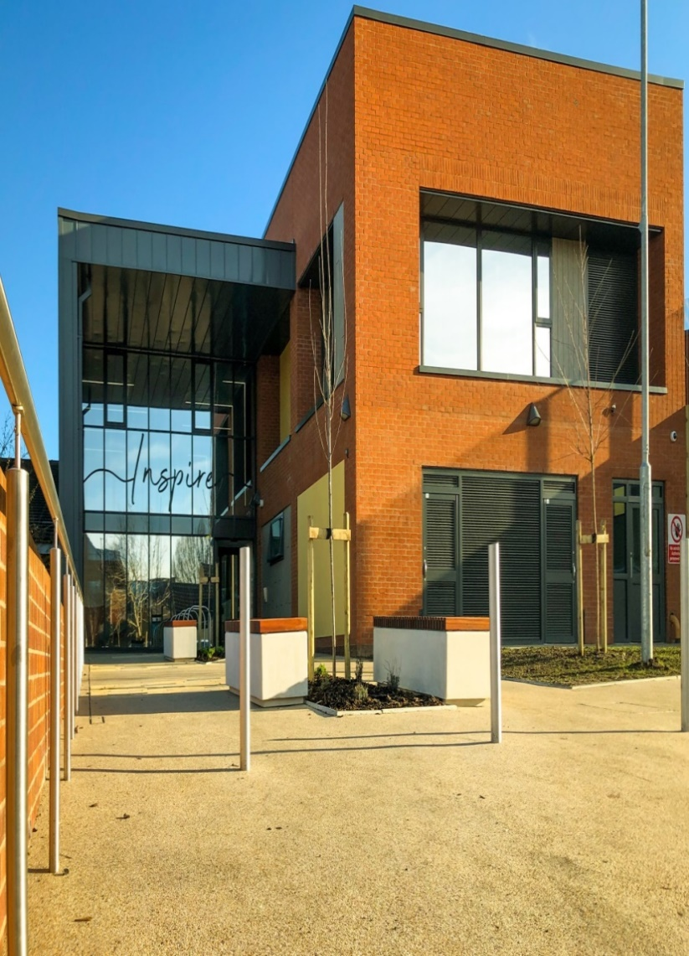
-------------------------------
Need photo - Team / house view??
CONTACT US
Single Point of Access number:
01653 609609
Please contact your GP, or 111 (which is available 24 hours a day, 7 days a week),
if you have an urgent medical problem and you’re not sure what to do
Please call 999 for urgent life-threatening matters at any time of day
Community Virtual Ward Service
Patient Information
“ A service to support patients to get the care they need at home “
Respect—Our staff will treat you with dignity and respect at all times. We expect polite behaviour towards our staff
No Smoking -To protect the health of our staff we will request that you do not smoke during our visits.
Privacy Notice - Your confidential information will be used and shared with those directly involved in caring for you, this will include health and social care professionals from Humber Teaching NHS Foundation Trust, York and Scarborough Hospitals Teaching NHS Foundation Trust and North Yorkshire County Council.
Complaints and Feedback Team
Humber Teaching NHS Foundation Trust
Trust Headquarters
Willerby Hill
Beverly Road
Willerby
HU10 6ED
01482 303930
HNF-complaints@nhs.net
HumberNHSFT
HumberNHSFT
This document is available in alternative formats on request. Email hnf-tr.communications@nhs.net or call 01482 301700
Publication Date: January 2023
Review Date: January 2024
Notes:
GUIDE:
Before saving as a PDF file for printing purposes, make sure to DELETE the two blue separating ‘fold’ lines.

Slide 2
Who is this service for?
Eligible patients must meet certain clinical criteria to be cared for by the Virtual Ward. Your nurse or doctor will assess whether you are suitable for the Virtual Ward. If suitable, you will be referred to the Virtual Ward Team.
How this service might be able to help you (not an exhaustive list):
Following a fall
During a rapid decline linked with frailty
Reduced function or reduced mobility
Palliative care/end of life crisis support
To manage an infection
Assessment and care at home
The Virtual Ward team will check-in with you on a daily basis via phone call or face to face visit. Patients can also get in touch with the Virtual Ward team at any time by phone.
Amendments to Your Care
The Virtual Ward team will be alerted if you are not recovering or responding to treatment as expected. Changes to your care plan can then be made by your clinical team without you having to return to hospital. For example, altering your medication dose or providing additional equipment to aid with your recovery. New medications can also be delivered to you if required.
Treatment Escalation Plan
The Virtual Ward team will provide you with a personalised treatment escalation plan on admission. This will highlight to you conditional changes to be aware of and signpost the necessary actions required.
What does the service do?
Virtual Wards allow patients to get the care they need at home, including care homes, safely and conveniently, rather than being in hospital (Hospital at Home). In a Virtual Ward, support can include remote monitoring using apps, technology platforms, wearables and medical devices such as pulse oximeters. Support can also involve face-to-face care from multi-disciplinary teams based in the community.
As part of our Community Ageing Well Programme, we have a team of Nurses, Physiotherapists, Occupational Therapists and Support Workers, who can provide this service, alongside a two-hour crisis response to help people living with frailty, multiple long term health conditions, and/or complex needs to stay independent and at home for as long as possible.
Equipment Provision, medical devices
One of our Virtual Ward nurses will meet with you to provide and teach you how to use the devices that are needed to safely monitor your health at home. You might be provided with a device called a ‘pulse oximeter’ which will enable you to take ‘readings’ each day of your oxygen levels and submit them to the Virtual Ward. The team will look at your readings remotely to monitor you and will make sure any issues are dealt with as soon as possible.
It may be helpful to supply you with equipment to enable you to be at home. Examples include; walking frames, commodes, pressure relieving mattresses. Equipment is supplied through an outside company called Medequip and will be delivered to your home.
Who does this service work with?
GP Practices, Hospital Discharge Teams, NHS 111 and ambulance services, and social care teams, as well as working alongside mental health, housing sector, voluntary sector, and community teams.
When is the service delivered?
The service operates 7 days a week, from 08:00 to 20.00. New referrals up to 18:00hrs Community Nursing teams can continue to help people at home overnight as needed.
How long can the team support you?
This depends on your individual assessment and health needs, and will be discussed with you. Initial support may be for up to 2 weeks. We may discuss referral to other community health and social care or voluntary sector providers with you, to support your ongoing care.
Which area is covered by this service?
The service is delivered across Scarborough and Ryedale / Whitby Community. There is no charge for this service.
Who do you call if you have any questions?
Please feel welcome to contact the team if you have any queries or concerns, and a Health Care Professional will get back to you.
The telephone number for the
Single Point of Access (SPOC) is:
01653 609609
Supporting young people
and their families in Hull and
the East Riding of Yorkshire.
Notes:
GUIDE:
Before saving as a PDF file for printing purposes, make sure to DELETE the two blue separating ‘fold’ lines.

